Slide 1
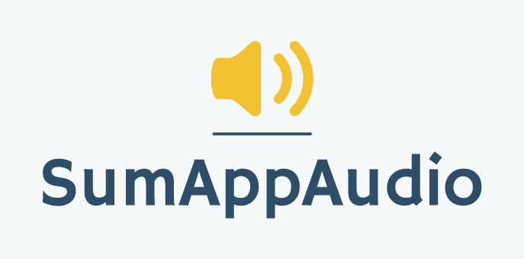
Improve dyslexics learning through a student-to-student model
Marco Carfora
Daniele Calisi
Francesco Bovi
Notes:
SumAppAudio is an application that aims to improve dyslexics learning through a student-to-student model.

Slide 2
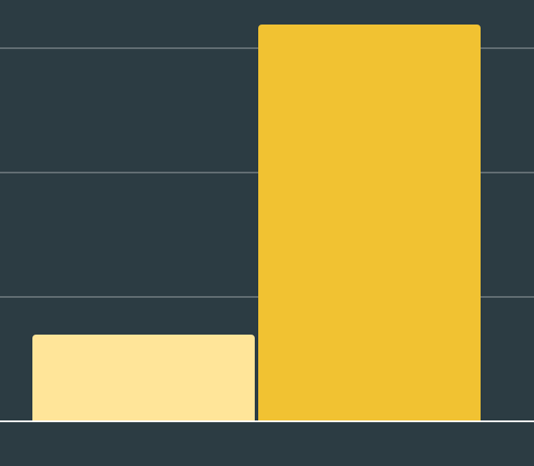
Trend: Awareness on dyslexia is rising
250.000 certified dyslexic students in Italy
3.2%*
0.7%*
2010
2018
*Certified dyslexic students among the total of students
Notes:
Nowadays the certified dyslexic students in Italy are 2 hundreds fifty thousand. In general, there has been a registered rise of dyslexia certification, from 0.7% in 2 thousand ten to 3.2% in 2 thousand eighteen , on the total number of students.

Slide 3



Dyslexics problems
Difficulties in reading and comprehending text
Lack of an easy way to grasp the concepts, making the learning slow
Struggle to autonomously review school subjects
Notes:
Dyslexic students have difficulties in reading and comprehending a text, therefore they don’t have an easy way to grasp the concept, so most of the time they ask for external help.

Slide 4


Dyslexics problems
Difficulties in reading and comprehending text
Lack of an easy way to grasp the concepts, making the learning slow
Struggle to autonomously review school subjects
Notes:
Dyslexic students have difficulties in reading and comprehending a text, therefore they don’t have an easy way to grasp the concept, so most of the time they ask for external help.

Slide 5


Dyslexics problems
Difficulties in reading and comprehending text
Lack of an easy way to grasp the concepts, making the learning slow
Struggle to autonomously review school subjects
Notes:
Dyslexic students have difficulties in reading and comprehending a text, therefore they don’t have an easy way to grasp the concept, so most of the time they ask for external help.

Slide 6
WOULD YOU HELP A DYSLEXIC CLASSMATE?
Notes:
Dyslexic students have difficulties in reading and comprehending a text, therefore they don’t have an easy way to grasp the concept, so most of the time they ask for external help.

Slide 7

Our solution
WHAT
HOW
WHY
Student-to-student model
Recorded audio files
Help dyslexics by summarising subject topics
Concept Maps
&
Textual notes
Notes:
Our solution is Sum-AppAudio, a digital platform based on a student-to-student model to support the learning of students with dyslexia. The core of the App are the recorded files that every student can upload to summarise subject topics or book chapters. The audio recordings can be supported with some attachments, like a concept map or a textual description, to cover both the auditory and visual channels.

Slide 8
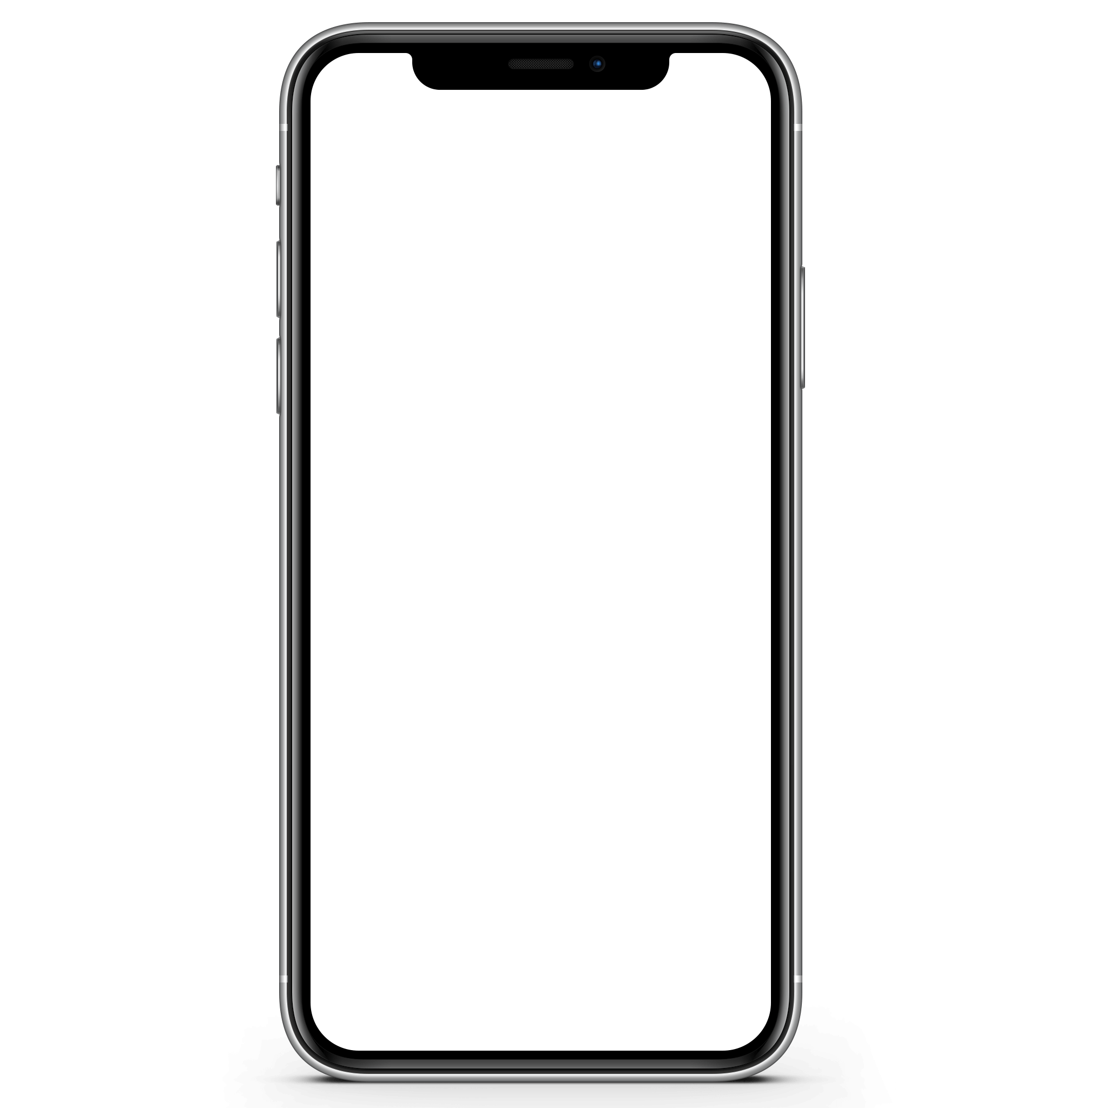

Main roles
Uploads recordings
NON-DYSLEXIC STUDENT
Notes:
Let’s see which are the main roles in our app:
non-dyslexic students, who can upload useful recordings for dyslexic ones;
dyslexic students who can listen recordings and give feedbacks;
and school tutors who can certify the recordings to give special feedbacks;

Slide 9

Main roles
Uploads recordings
Listens to recordings
NON-DYSLEXIC STUDENT
Gives feedbacks
DYSLEXIC STUDENT
Notes:
Let’s see which are the main roles in our app:
non-dyslexic students, who can upload useful recordings for dyslexic ones;
dyslexic students who can listen recordings and give feedbacks;
and school tutors who can certify the recordings to give special feedbacks;

Slide 10

Main roles
Uploads recordings
Listens to recordings
NON-DYSLEXIC STUDENT
Gives feedbacks
DYSLEXIC STUDENT
Certifies recordings
TUTOR
Notes:
Let’s see which are the main roles in our app:
non-dyslexic students, who can upload useful recordings for dyslexic ones;
dyslexic students who can listen recordings and give feedbacks;
and school tutors who can certify the recordings to give special feedbacks;

Slide 11
Questionnaires
MVP
Domain experts
Validation Methods
208 total answers among students and tutors
53 testers
Pierluigi Zoccolotti
&
Stella Totino

Slide 12
Validation: students involvement

Slide 13
Validation: students involvement
UPLOADING AVAILABILITY
91.2%
of questionnaires answers
(With an average frequency of 2-3 days)

Slide 14
Validation: students involvement
UPLOADING AVAILABILITY
91.2%
of questionnaires answers
(With an average frequency of 2-3 days)
DAILY LISTENING FREQUENCY
53.8%
of questionnaires answers

Slide 15
Validation: WHY should students upload?

Slide 16
Validation: WHY should students upload?
EARLY ADOPTERS PHASE
(students in Rome with a dyslexic classmates)
88.6%
would help a classmate

Slide 17
Validation: WHY should students upload?
EARLY ADOPTERS PHASE
ADVANCED PHASE
(students in Rome with a dyslexic classmates)
88.6%
would help a classmate
Reward system based on discounts and gift cards

Slide 18
Validation: tutors involvement
EARLY ADOPTERS PHASE: TUTORS FROM DIRECT CONTACT
ADVANCED PHASE: TUTORS FROM SCHOOLS PARTNERSHIPS

Slide 19
Validation: tutors involvement
EARLY ADOPTERS PHASE: TUTORS FROM DIRECT CONTACT
ADVANCED PHASE: TUTORS FROM SCHOOLS PARTNERSHIPS
CERTIFYING AVAILABILITY
93.3%
of questionnaires answers

Slide 20
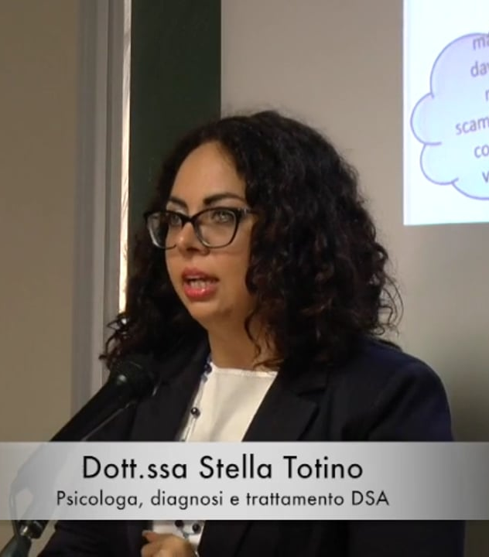
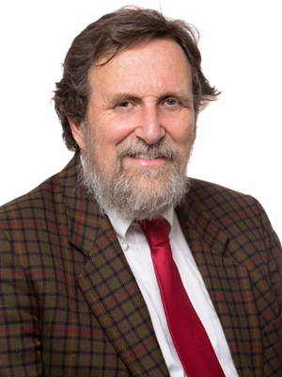
Validation: Usefulness of the system
Stella Totino
Pierluigi Zoccolotti
“Useful for every DSA student”
User interface suggestions: visual channel, voice synthesizer, EasyReading font
“Useful aid for university students with specific learning difficulties”
“well-made audio summaries can represent a positive element in the study”

Slide 21

Validation: Usefulness of the system
Through MVP: Audio samples made by ourselves for dyslexic students
Athens
Respiratory System
Assyrians
Sparta
88%
of positive feedbacks

Slide 22
Market size
(based on business model)
TAM
2.2 Bln
About students in the world
SAM
0.8 % of TAM
About students in Italy
About students in Rome
(middle and high school)
with a dyslexic in class
SOM
1.7% of SAM
Notes:
The T.A.M we’ve considered for the application is the advertisement revenue on the total number of students worldwide, then the S.A.M is the percentage of revenue obtained by the students in Italy, that’s to the 0.8% of the T.A.M. Finally the S.O.M, that will be also our early adopters, are the students in Rome with at least a dyslexic in class, it corresponds to the 1.7% of the S.A.M.

Slide 23
Revenue model
REVENUES FROM FREE VERSION:
banner advertisements with students as target
REVENUES FROM PREMIUM VERSION:
partnerships, cost of subscription

Slide 24

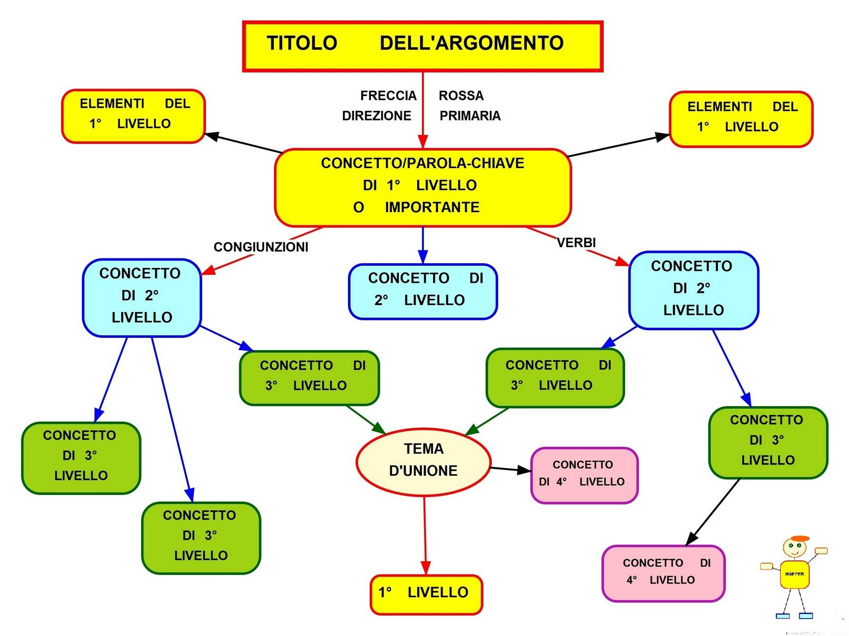




Competitor Analysis
Student-to-student system
Concept maps
Ad hoc Textbooks
Voice synthesizers
Ad hoc audio for dyslexic students
Notes:
Ok, let’s see now a quick competitor analysis that we focused on the two main aspects of the platform. As you can see there ARE some alternatives, like skuola.net or concept maps, based on a student to student model but without the audio feature; Or alternatives like voice synthesizers-and tutors, which are more audio oriented but with the lack of a students community.

Slide 25
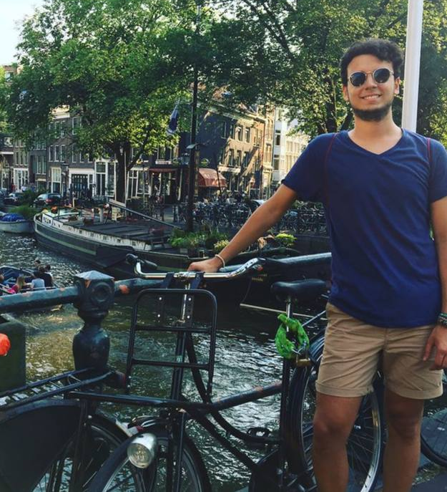
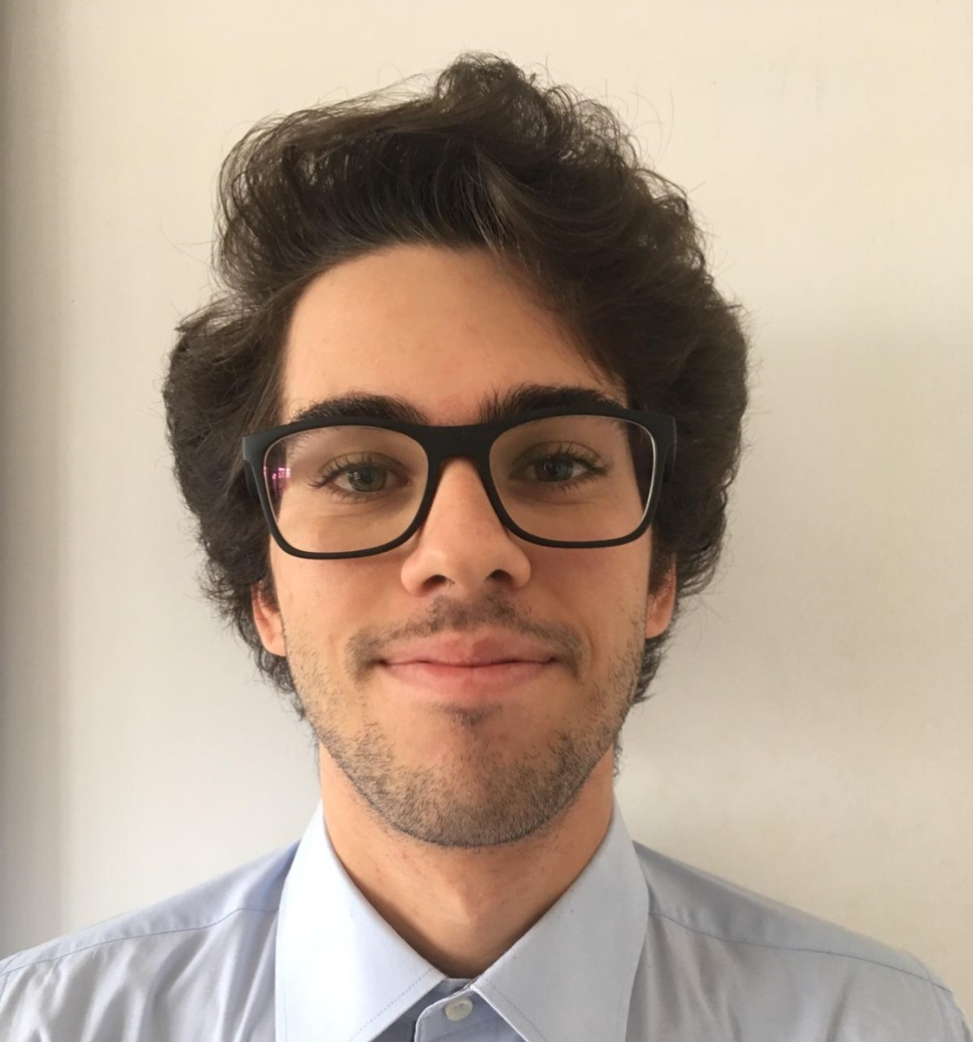
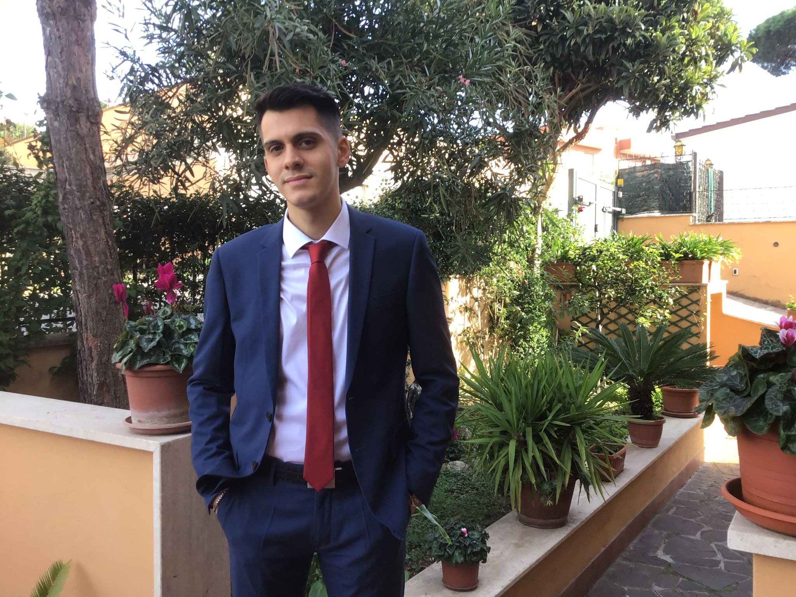

Team
MARCO CARFORA
DANIELE CALISI
FRANCESCO BOVI
Web design frontend
Mobile developer
Neural networks
Web design backend
Data management
Machine Learning
Software Developer;
Cybersecurity;
AI experience;
https://www.linkedin.com/in/marco-carfora-55707a198/
https://www.linkedin.com/in/daniele-calisi-4088a11a6
https://www.linkedin.com/in/francesco-bovi-a450ab207/
Notes:
This last slide is just a recap about us. We are three students with all the capabilities to proceed in this project. With Marco specialized in frontend, Daniele for the backend, and Francesco with his Software developer skills.

Slide 26


THANK
YOU!
sumappaudio@gmail.com
https://www.facebook.com/SumAppAudio

Slide 27
Business Concept
During the last years the awareness on the dyslexia is increased. Indeed, it has been registered a raise of students with certified dyslexia (177.000 cases in Italy), from 0.7% in 2010 to 3.2% in 2018 but the number is probably higher.
Students affected by dyslexia have difficulties in reading a text and troubles copying from the blackboard. They don’t have a way to easily grasp the concepts and to make the comprehension faster, indeed they usually need external help, like a tutor.
Sum-AppAudio is a digital platform based on a student-to-student model to support the study of students with dyslexia. The core of the App are the recorded files that every student can upload to summarise subject topics or book chapters. The system is designed ad hoc to overcome the difficulties that students with dyslexia have to face but also other students can enjoy the service.

Slide 28
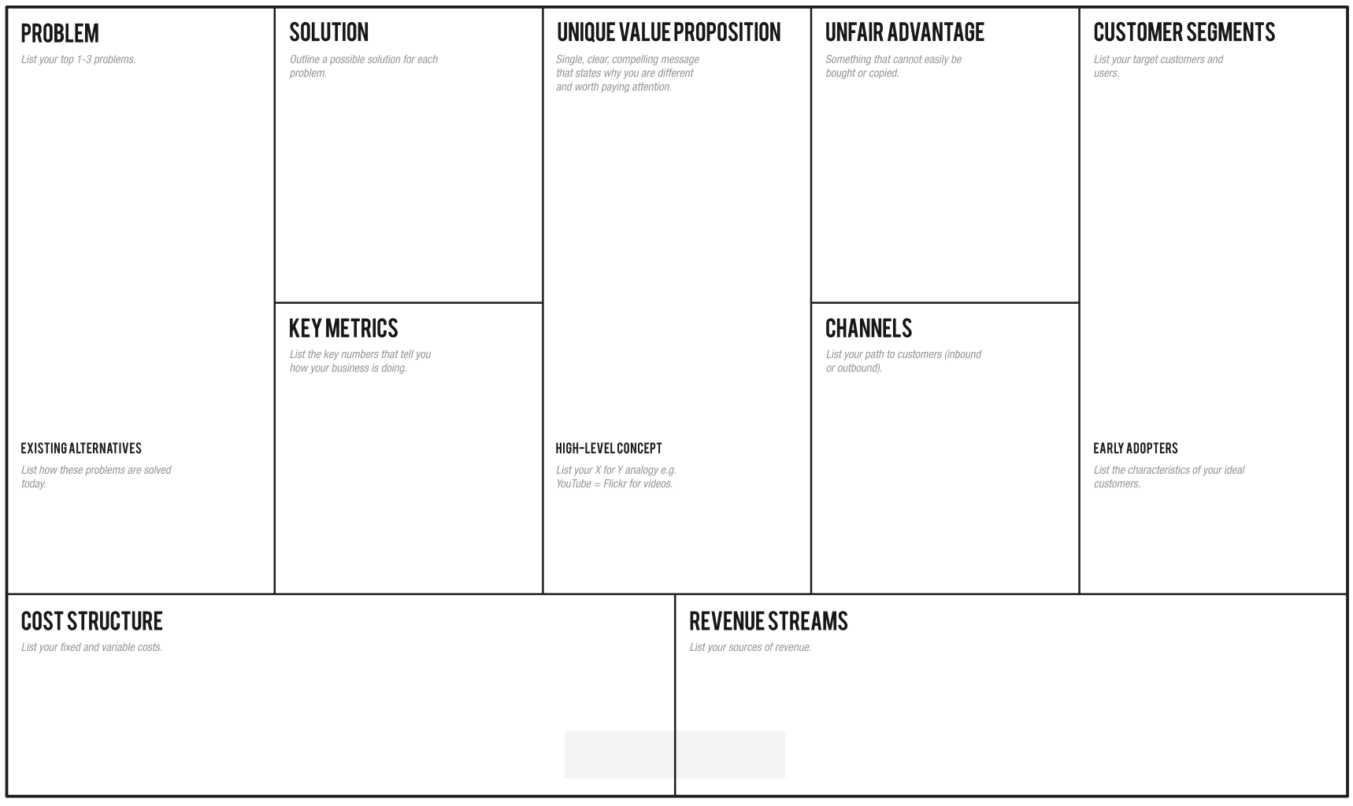

-Students with dyslexia have difficulties in reading and comprehending a text:
-They don’t have a way to easily grasp the concepts, making the learning slow.
-They need an easy way to autonomously review school subjects, indeed they usually ask for external help
Through the app the students can learn in an easier and efficient way, avoiding tiring readings, relying on recordings from a huge collection built thanks to a lot of students' support
Overcome your reading and learning difficulties, enjoy a student-to-student model whose core are the recorded files that every student can upload to summarise subject topics or book chapters for students with dyslexia.
-Students with dyslexia problems (2% from primary schools, 5.6% from middle schools, 4.7% from high schools).
-Schools and pedagogical associations -Support teachers.
-Every student who wants to help other ones.
-Number of produced and listened recordings (monthly).
-Content quality trends thanks to feedback system.
-How many results appear for a single topic.
-How many people use the app regularly (rate of accesses)
-Flyers distribution in front of selected schools and associations of this sector.
-A social page dealing with dyslexia problem.
-Meetings in school where we present our project to students.
- Selected classes with a dyslexic student in Rome schools, so classmates can help each other -Tutors / Support teachers
Skuola.net, ad hoc textbooks, Youtube, voice synthesizers, tutors, concept maps
Sum-AppAudio = Spotify for school summaries.
-Server/database maintenance;
-Channels’ cost;
-Gift cards at a later time
- Banner advertisements;
- Freemium App (subscription)
- Partnerships with schools/associations;
- Partnerships with publishing companies to certify their content;

Slide 29
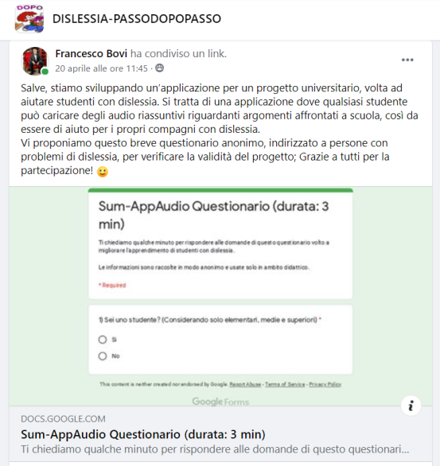
Students Questionnaire
CONTENT SUMMARY:
Degree of satisfaction with the current study method.
Degree of satisfaction with the supporting material available (only for dyslexic students).
Usefulness of the student-to-student audio system.
Availability in uploading recordings (with or without incentives).
Addressed to: Scholars and ex-students, dyslexic and not.
Where: Our contacts, facebook groups about dyslexia.
Questionnaire Link: https://forms.gle/JzLLyL3t9WeL8Aqm6

Slide 30

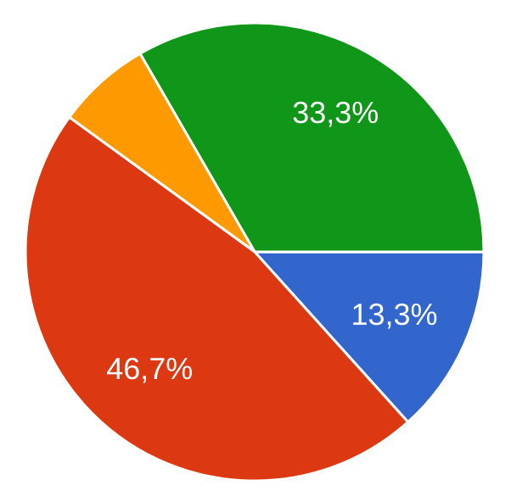
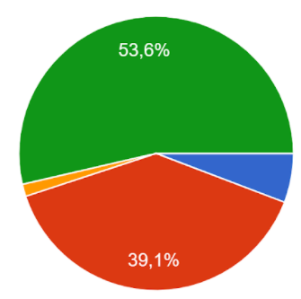
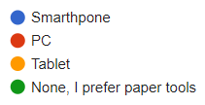
Results of the Students questionnaire (1/4)
Which technology did you use the most during the study?
Students: Ex-Students:
We can clearly see a trend in which new generations of students prefer electronic devices during the study than paper tools.
Moreover, the use of PC is predominant, but the use of smartphone is increasing;
Action:
The application should be developed both for PC and smartphone, not only on the latter as we initially thought.
Total number of answers: 131
Grouped by:
Dyslexic Students: 15
Dyslexic ex-Students: 13
Non-Dyslexic Students: 34
Non-Dyslexic ex-Students: 69

Slide 31
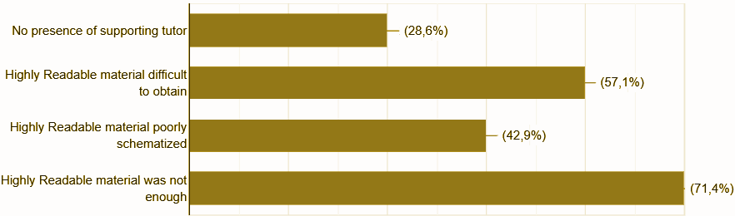
Results of the Students questionnaire (2/4)
We’ve seen that compared to ex-students, the new generations are generally more satisfied with their study method, but there are some issues that are still problematic:
Most common dissatisfaction reasons:
We’ve seen that compared to ex-students, the new generations of dyslexic students are generally more satisfied with their study method, but there are some issues that are still problematic:

Slide 32
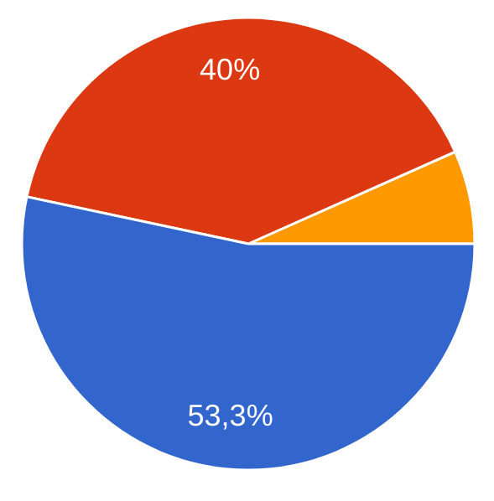
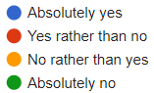
Results of the Students questionnaire (3/4)
Why? (positive answers) - 93,3%
They would be direct and easy to comprehend (50%)
it would speed up the study (42%)
They would help me to better grasp and memorize the concepts (35%)
Why? (negative answers) - 6,7%
Audio could be incorrect or unreliable (40%)
Audio would be difficult to understand (20%)
Concepts could be badly explained (60%)
To avoid an unreliable system we have a feedback system based on other students and tutors marks.
Question: (for dyslexics only): Do you think that audio summaries, made by other students, could help you in the study?

Slide 33
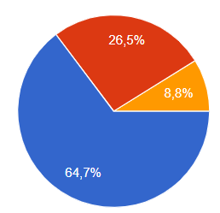
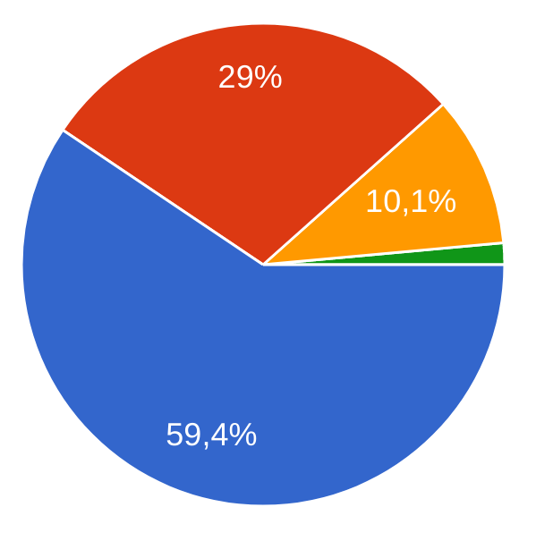
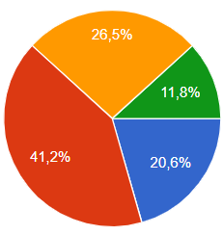
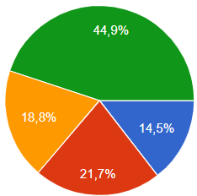
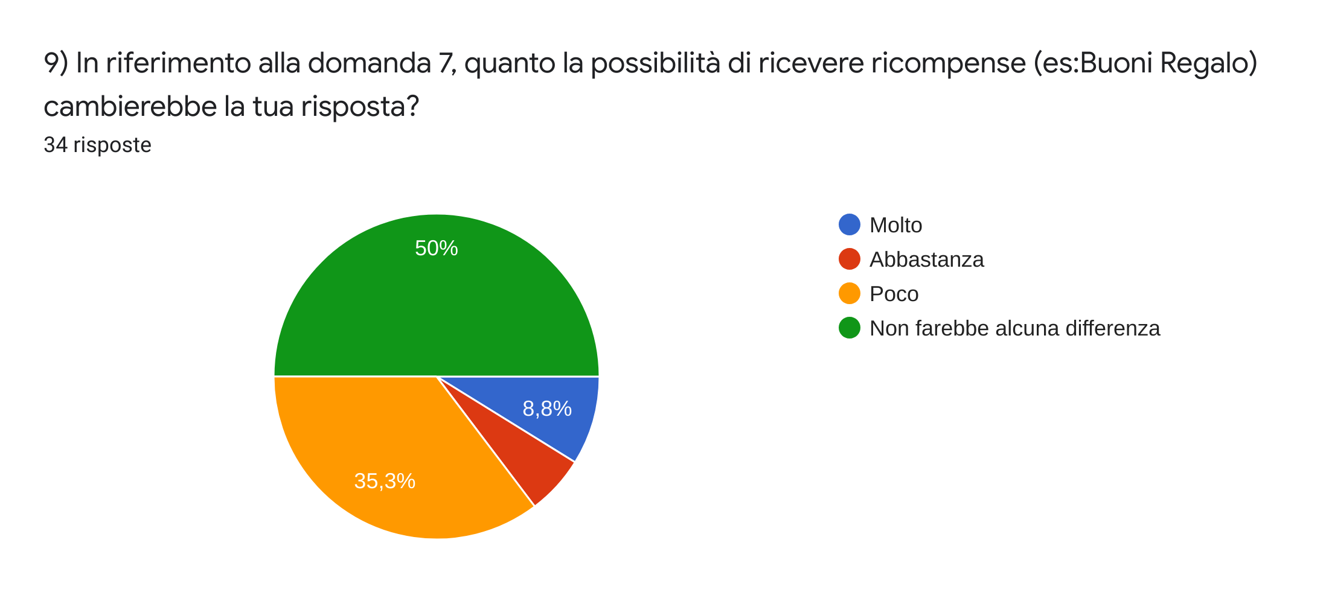
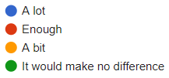
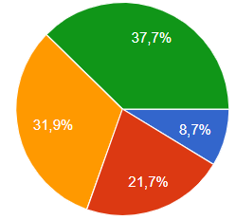
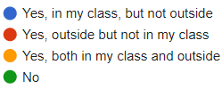
Results of the Students questionnaire (4/4)
Would you be willing to upload recordings in the App?
Students Ex-students
We can highlight a trend: new generations of students are more available to help their acquaintances with recordings
With respect to the question above, how much you would change your answer if the App included a reward system (based on Gift Cards)?
Students Ex-Students
Action: We decided to remove gift card for the first period
Questions:
Do you know dyslexic students? If yes, they are in your class or outside of it?
Students Ex-Students

Slide 34
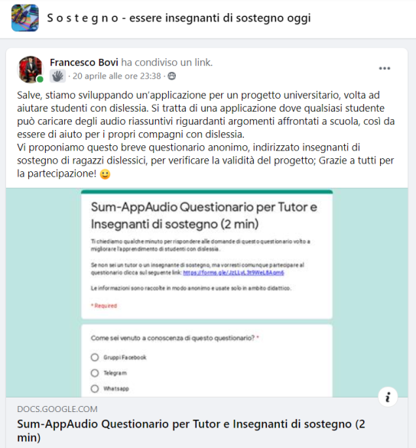
Tutor
Questionnaire
CONTENT SUMMARY:
Degree of satisfaction with student’s current study method.
Degree of satisfaction with the supporting material available.
Usefulness of the student-to-student audio system.
Availability in the evaluation of the recordings.
Addressed to: Support teachers and private tutors;
Where: Our contacts, facebook groups about school tutoring;
Questionnaire Link:
https://forms.gle/CLrzM3CAkxBQKcDU7

Slide 35
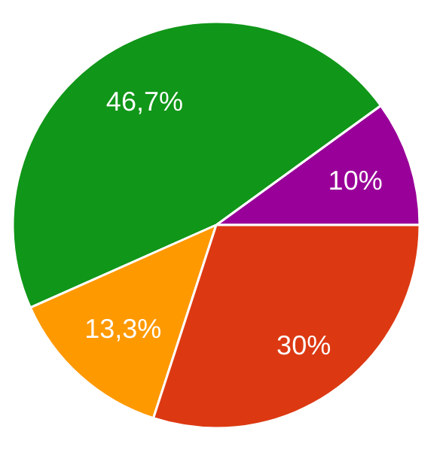
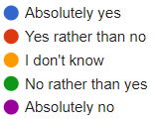
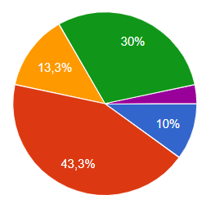
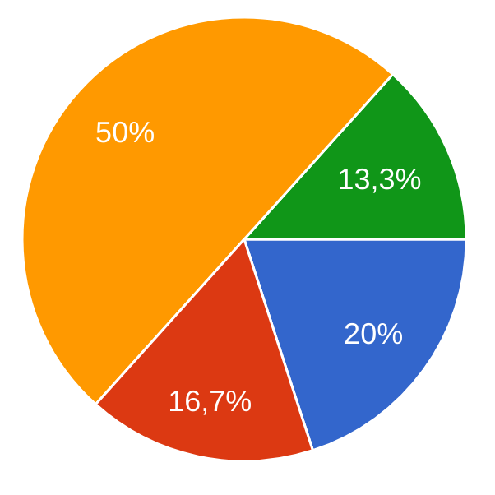
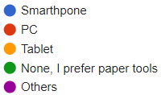
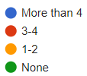
Results of the Tutor questionnaire (1/2)
Are you satisfied with educational tools to teach to dyslexic students
Which technology do you use the most to support your students?
Total number of answers: 30
Questions:
How many dyslexic students do you follow weekly?

Slide 36
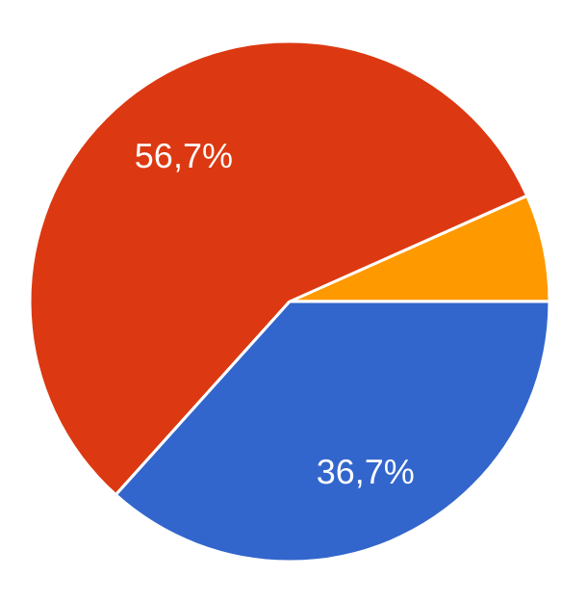
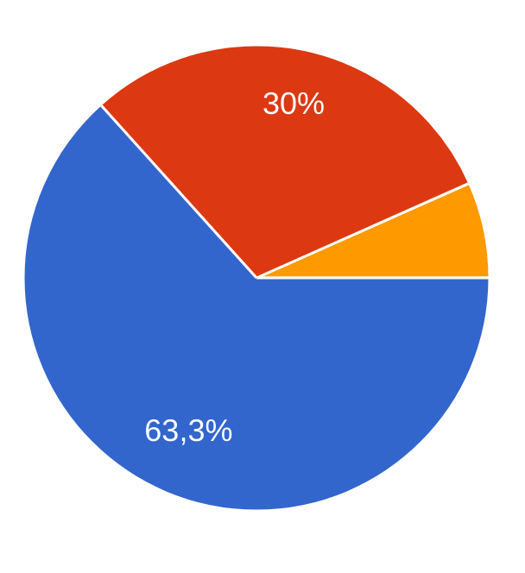
Results of the Tutor questionnaire (2/2)
Questions:
Do you think that audio summaries, made by other students, could help dyslexic students?
Would you be willing to leave feedbacks to certify the best recordings?

Slide 37



Comments from questionnaires
Actions:
Add: guidelines for audio creators (specific titles, clear concepts, loud voice, short recordings, repetition of principal concepts, chronological order)
Add: optional concept maps together with the recordings
Add: show up authors nicknames
Suggestions:
Audio content quality must be high;
Concept maps attached can help to understand better recordings;
Highlight the nickname of the content’s creator;
It can be useful also for other disorders (blindness, loss of concentration).

Slide 38

Minimum Viable Product
What:
To verify the usefulness of the audio system for dyslexic students, we have contacted a few and provided them some audio recordings; they listened the audio and evaluated the quality, thus to give us a feedback.
Audio samples:
Addressed to: Dyslexic students;
Where: Through our contacts (family, friends, acquaintances)
Respiratory System
Assyrians
Athens
Sparta

Slide 39
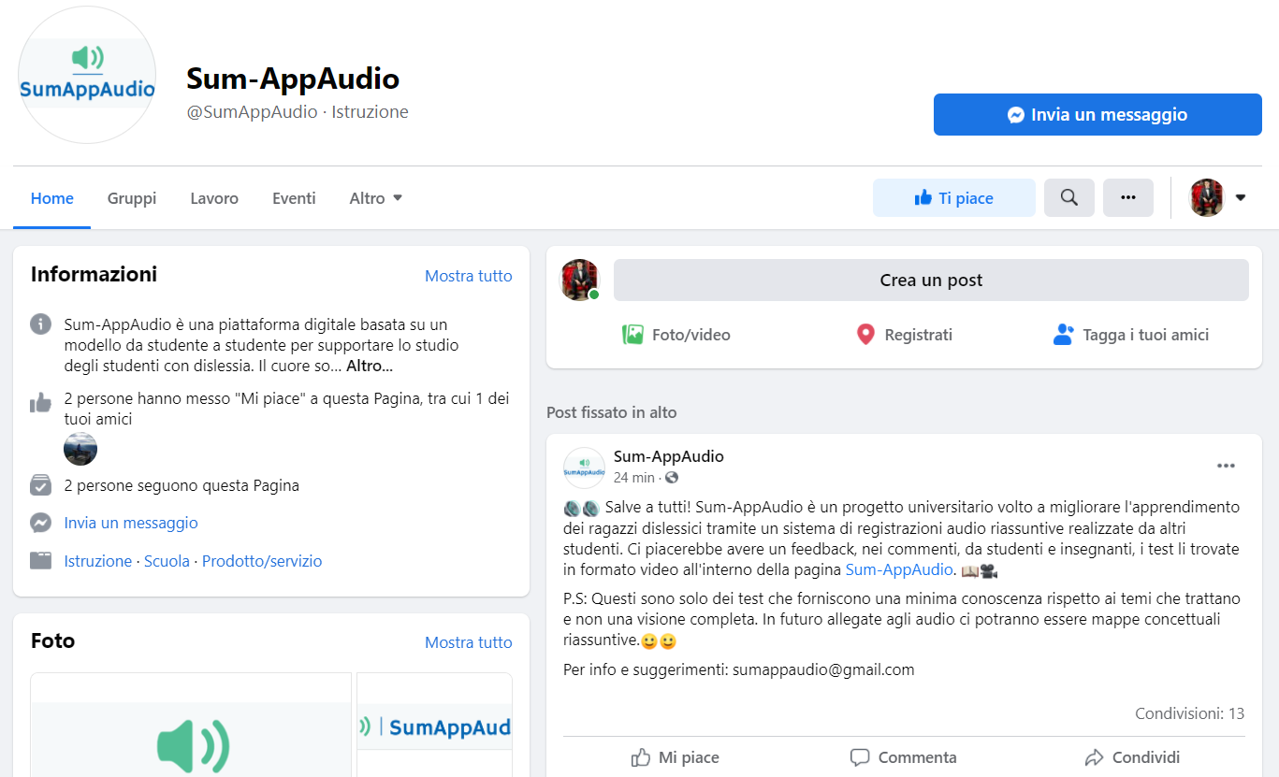
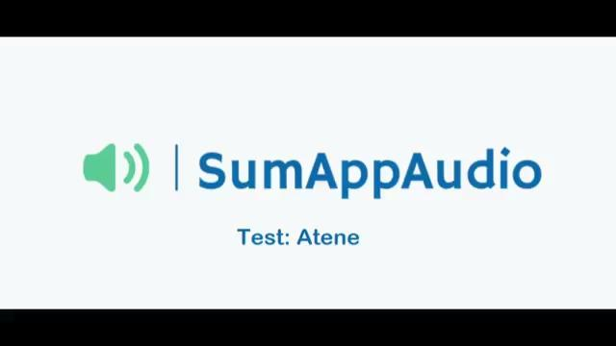
Landing Page
What:
A landing page, with all information about the application, that offers the possibility to hear the audio samples and give a feedback.
Goal: Expand MVP audience
Where: Shared on Facebook groups about dyslexia.

Slide 40
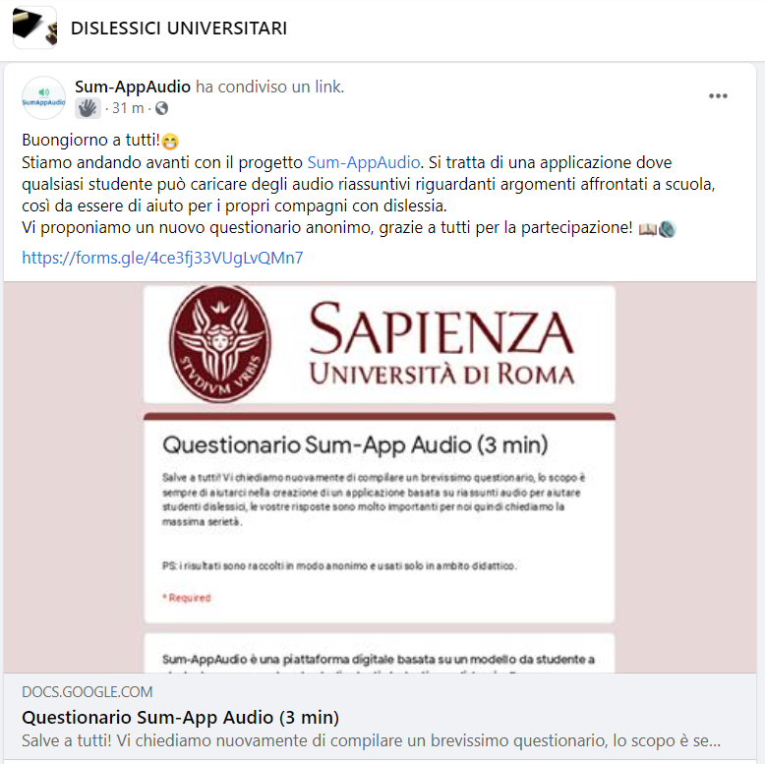
New Questionnaire
CONTENT SUMMARY:
Audio tools usage in the current state of art; (only for dyslexic)
Frequency of uploading and listening of the recorded content;
Usage of other competitors
Comments on audio tests
Economic questions (App price, donations..)
Addressed to: Scholars and ex-students, dyslexic and not.
Where: Our contacts, facebook groups about dyslexia.
Questionnaire Link: https://forms.gle/QuVuZAP4pvYhy48HA

Slide 41
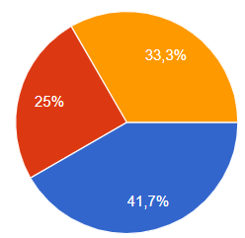
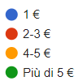
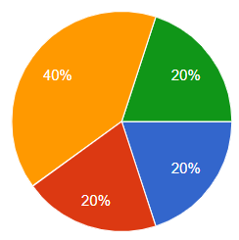
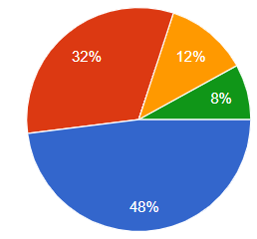
ECONOMIC ASSUMPTIONS (Students)
Usefulness of gift cards to incentivize uploadings
Availability to donate
Amount that customers would pay to purchase the App
Preference w.r.t. free App with digital banners

Slide 42
Expert Opinion (1/3)
Stella Totino
Pierluigi Zoccolotti
Psychologist;
Psychotherapist;
Neurodevelopmental disorders, in particular DSA, ADHD, language disorders and study method.
Diagnosis of affective and relational disorders associated with DSA (University of Urbino Carlo Bo).
Psychologist;
Member of the Editorial board of “Annals of Dyslexia”;
Member of the scientific group of Fondazione Italiana Dislessia;
Director of PhD in “Disturbi dell’apprendimento e dello sviluppo cognitivo”;
Professor in La Sapienza University.

Slide 43
Expert Opinion (2/3)
“I think that making audio summaries can certainly be a useful aid for university students with specific learning difficulties.
In my opinion, the presence of aids should never completely replace exercise and, where possible, targeted rehabilitation interventions, but certainly the availability of well-made audio summaries can represent a positive element in the study, especially for children with reading difficulties.”
Pierluigi Zoccolotti

Slide 44


Expert Opinion (3/3)
-“The App can be useful for every DSA student, for example dysorthographia;”
-“In a lot of cases, the audio channel alone is not enough for an easy comprehension; therefore the App should include also a sort of visual channel: concept map and written text; “
-“The App should offer the possibility to parse the text shown with a voice synthesizer.”
-“The App should use a specific font useful for DSA students (EasyReading);”
Stella Totino
-

Slide 45
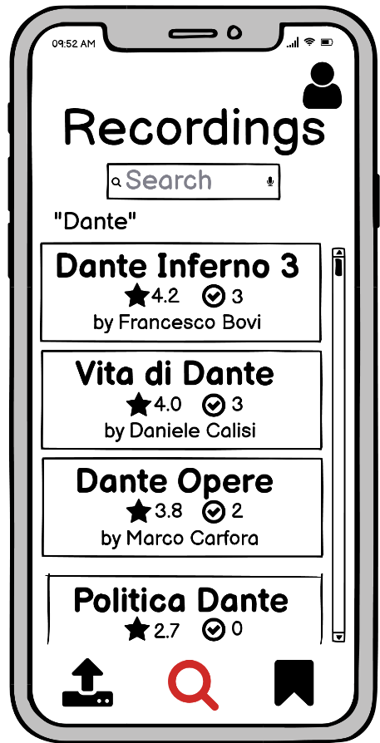
Recordings search Mockup
Current
Search
“EasyReading”
text font
Big
titles
Tutor Certifications
Holding down any title, the user can reproduce it with a voice synthesizer
Students Rating

Slide 46
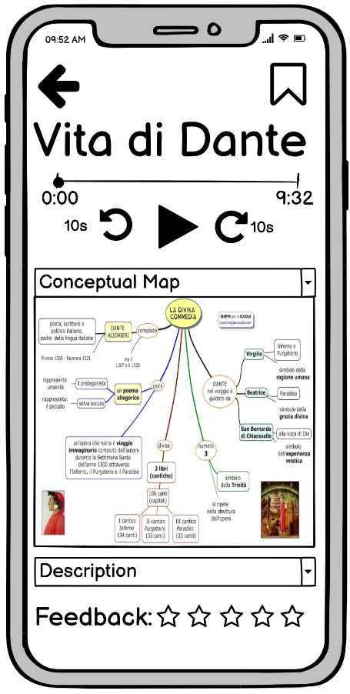


Recording details
Mockup
Concept Map
Playback managing
Description
Concept maps and descriptions aren’t optional: the user can upload them manually ( ), otherwise they are obtained automatically ( ).
Student Feedback

Slide 47


App Versions
 | Free | Premium
Concept maps
Textual Description
Audio recordings
Ads removal
Partners (e.g. Mondadori)
Uploaded by students
Notes:
There are free and premium versions of the application. The premium features are: the removal of advertisement and the adding of “Certified partnerships content”, so access to high quality material published by popular editors (like Mondadori).

